Slide 1
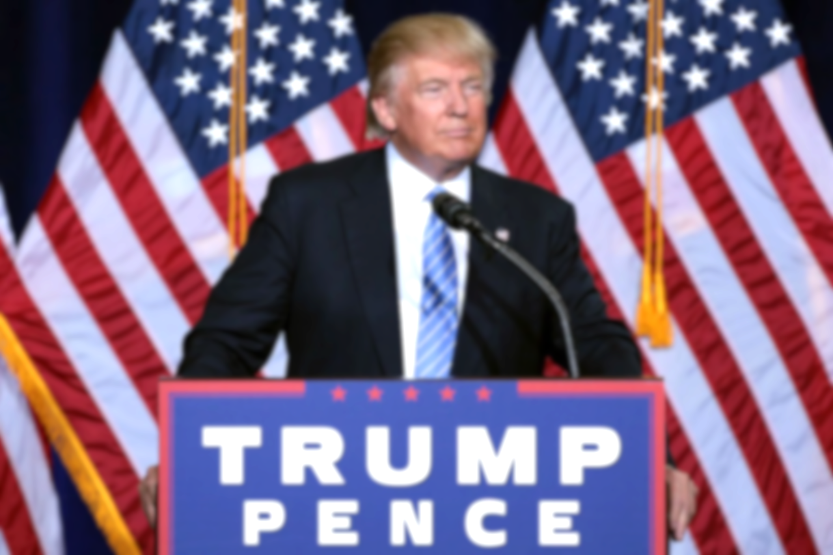
Analyzing Trump’s Speech
Analyzing Trump’s Speech
Here is where your presentation begins
By :Hind Alamri
This Photo by Unknown Author is licensed under CC BY-SA

Slide 2
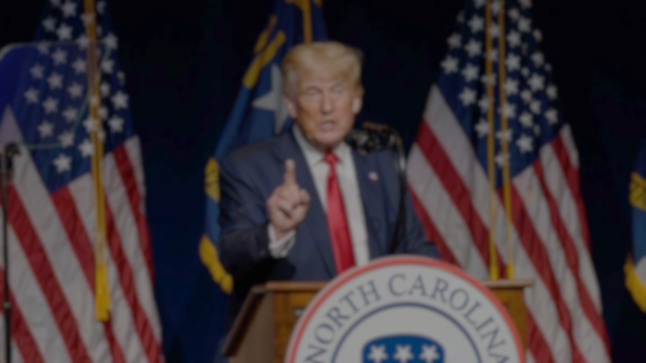
PROJECT GOAL
Build unsupervised learning models that focus on finding meaningful topics on Donal Trump ’s speechs .

Slide 3
01
Project Introduction
02
Data and EDA
Lemmatization and Visualization
03
Topic Modeling
04
Agenda
Here you could describe the topic of the section
Here you could describe the topic of the sectio
Here you could describe the topic of thesection

Slide 4





فيسف
VENUS
Tools

Slide 5

Data and EDA
Contain one Column and 73 speechs.

Slide 6
Workflow
Vectorization
Lemmatization
Data Cleaning
Remove Most Common Words
Topic Modeling
Despite being red, Mars is a cold place, not hot
Mercury is the closest planet to theSun

Slide 7
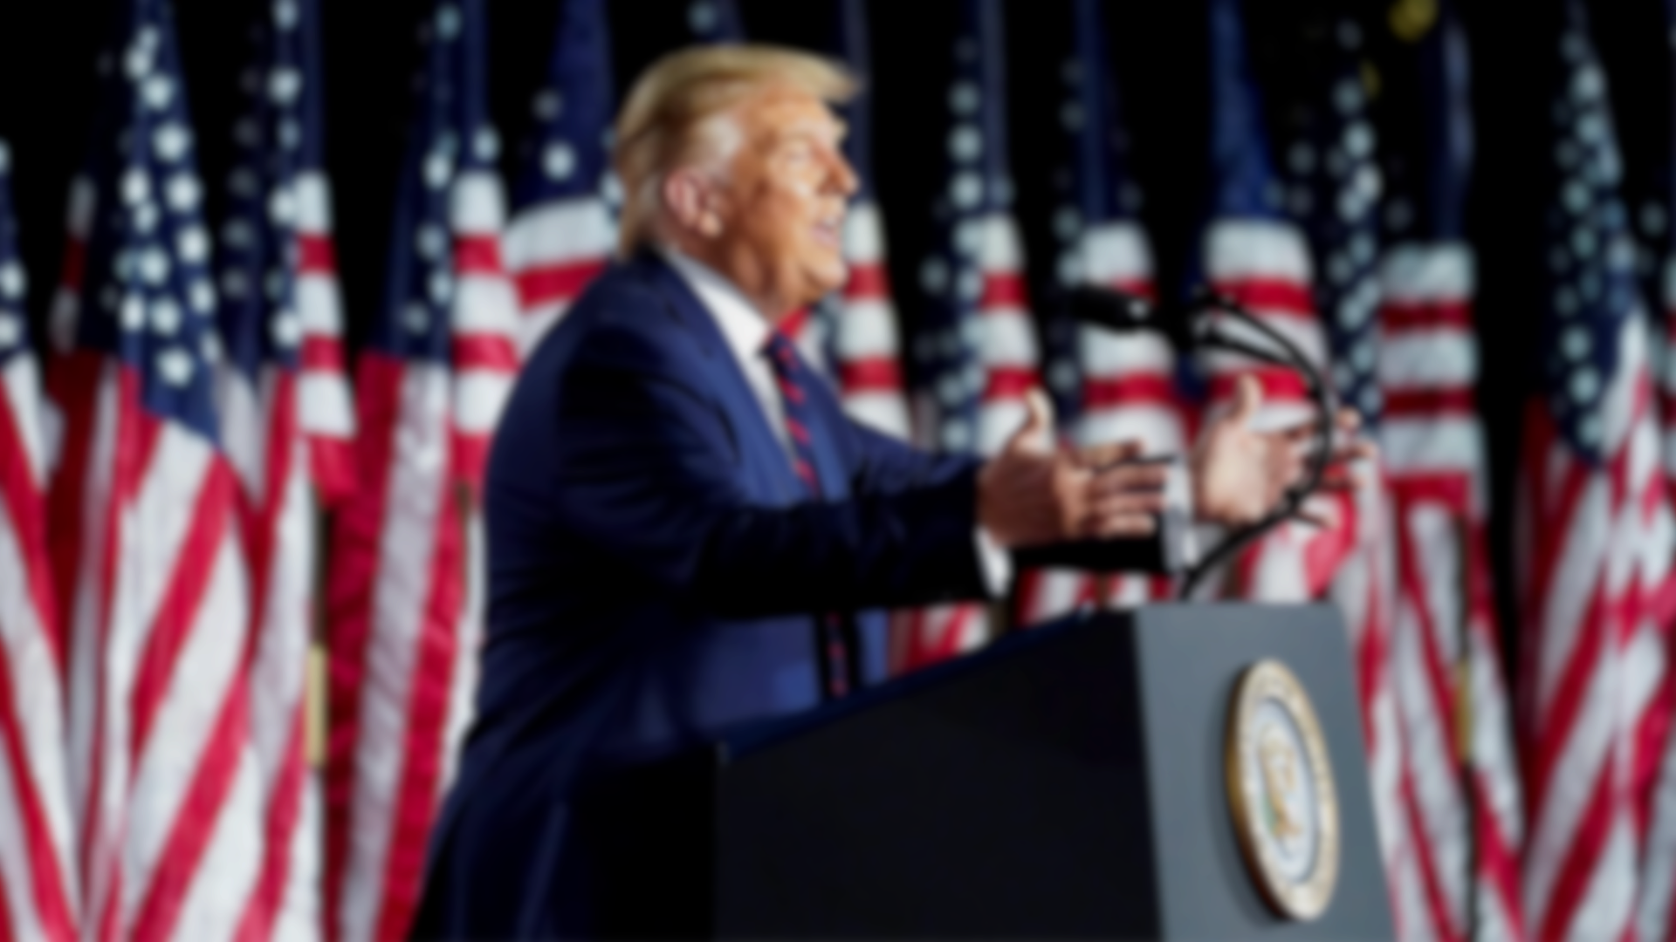
Data Cleaning
1-Split by Whitespace and Remove Punctuation
2-emoticons symbols & pictographs
3-Change shortcuts
4-Normalize the word

Slide 8
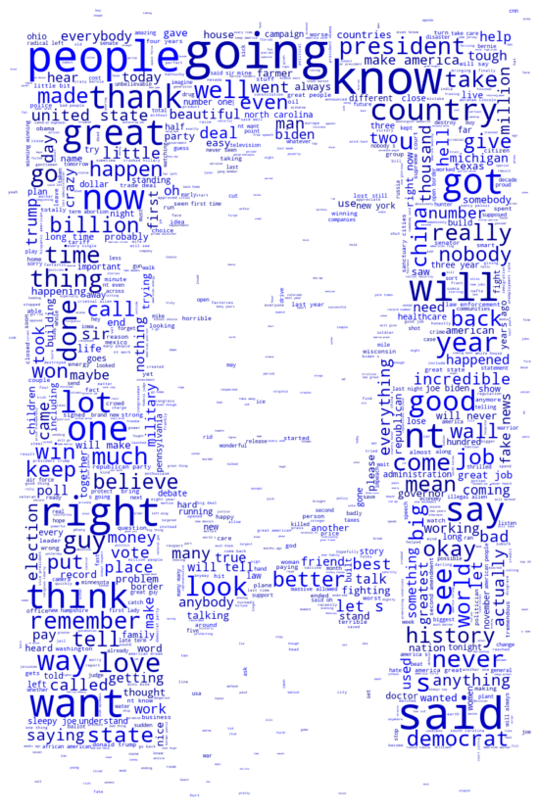
Words after Cleaning texts

Slide 9
Lemmatization
NOUN
ADJ
VERB

Slide 10
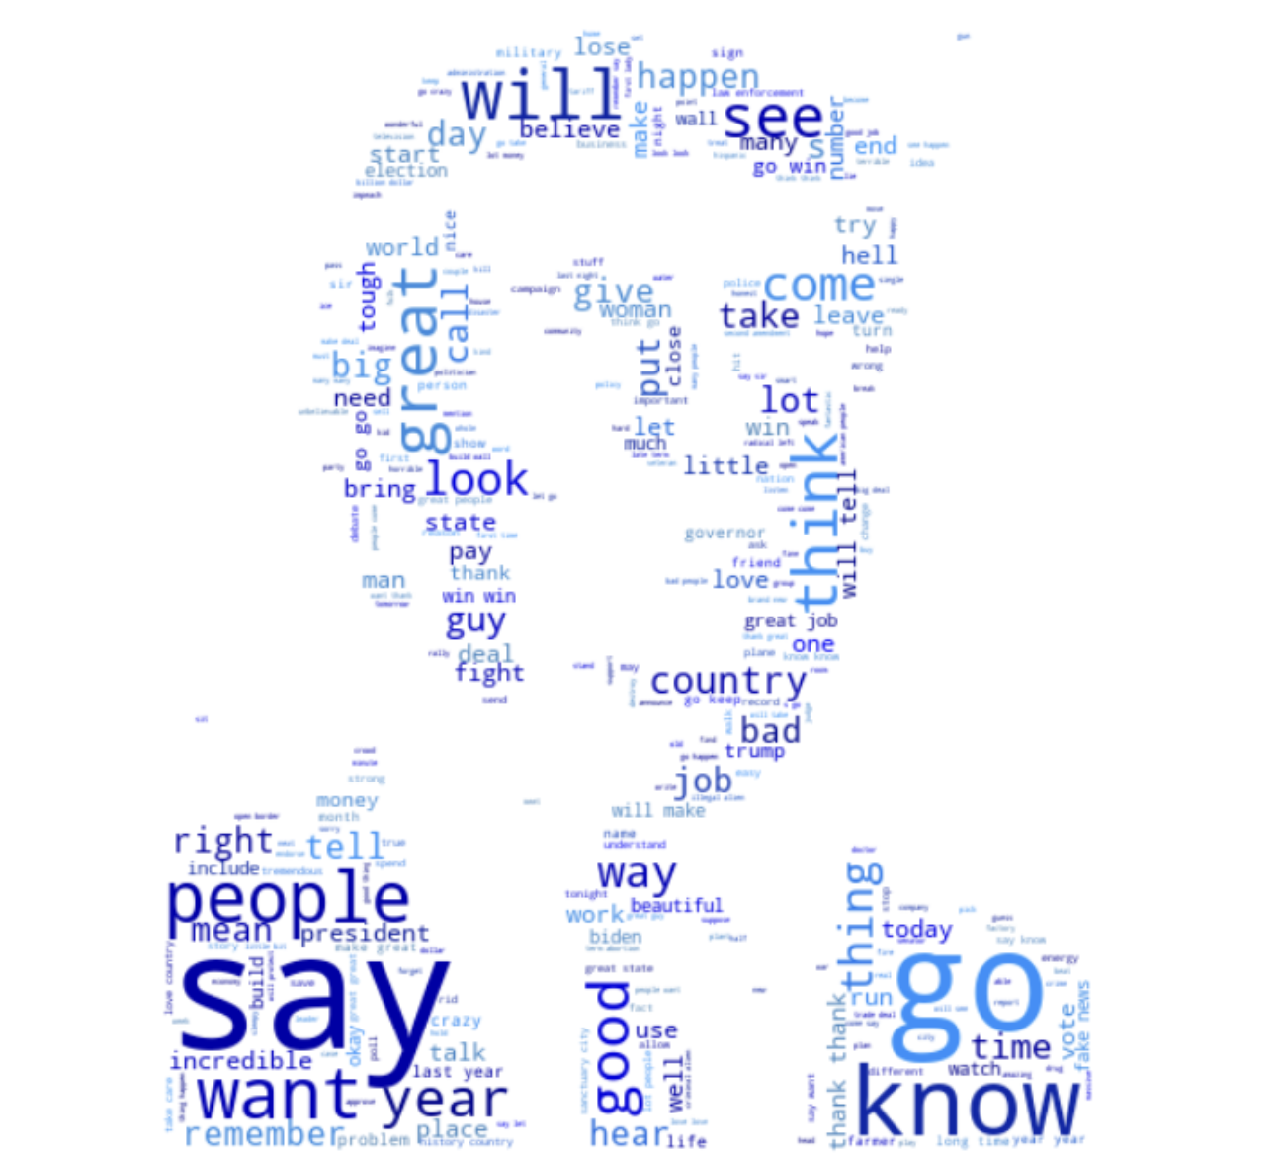
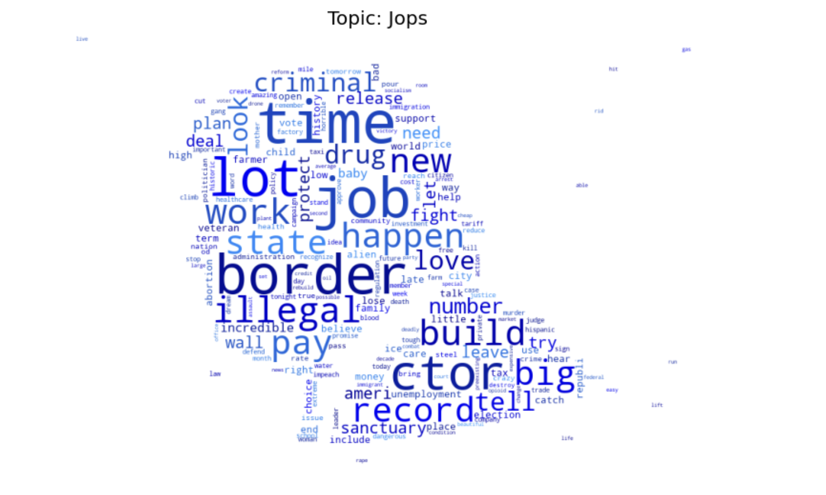
Words after Lemmatized texts

Slide 11
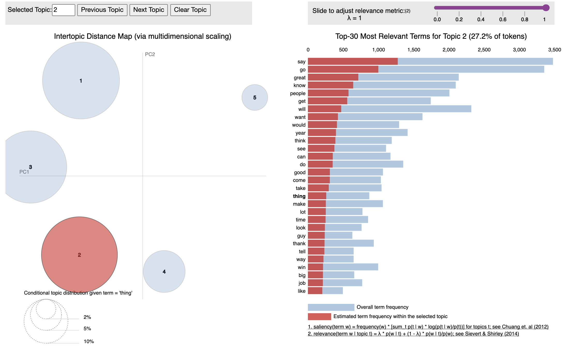
Python library for interactive topic model visualization

Slide 12
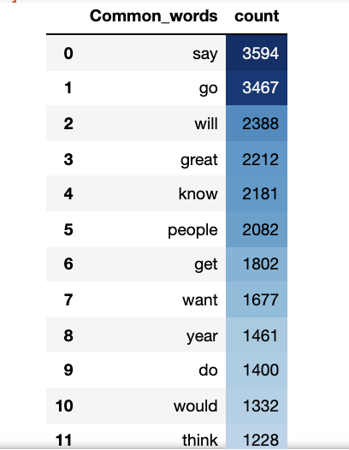
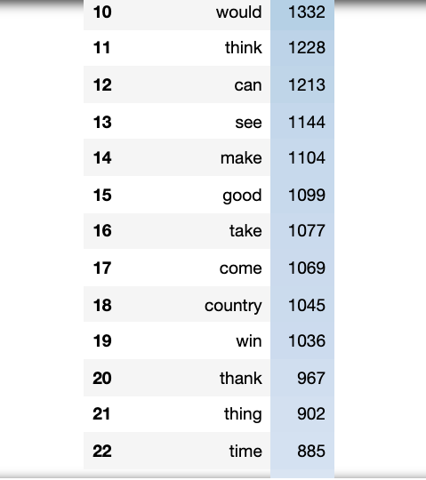
22 Most Common Words

Slide 13
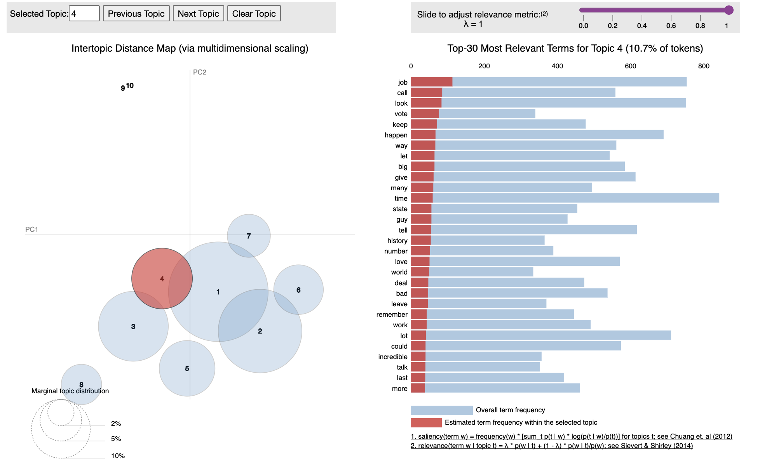
Python library for interactive topic model visualization

Slide 14
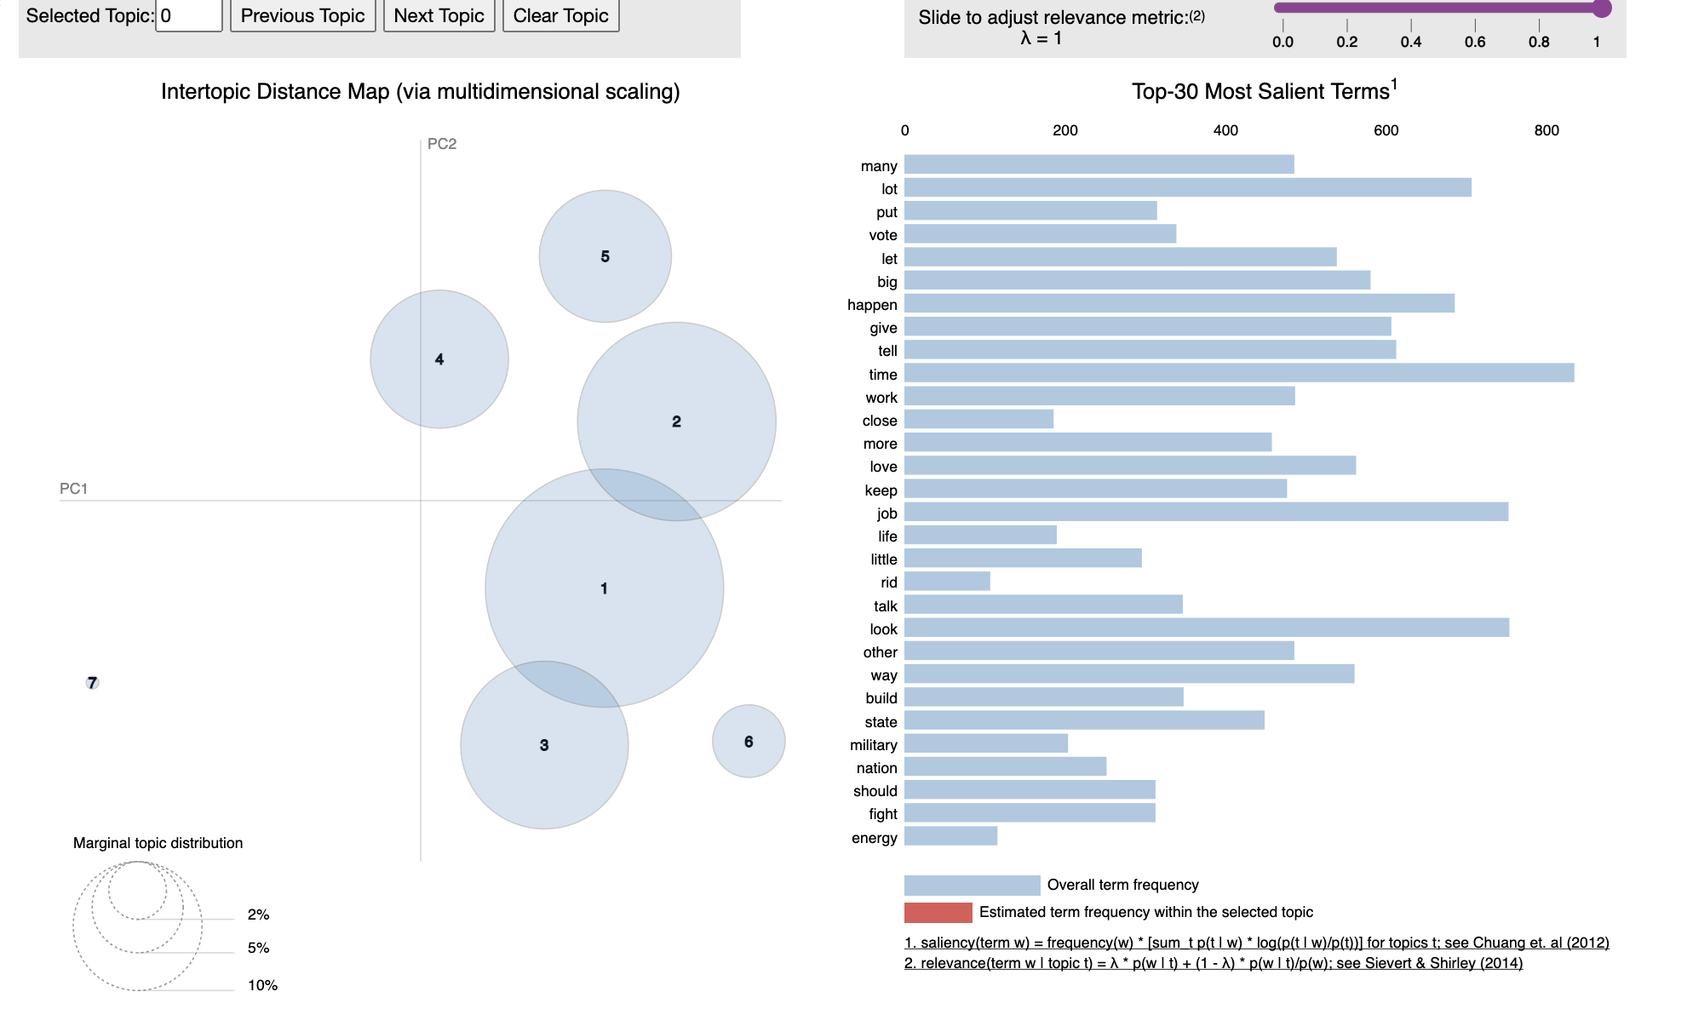
Python library for interactive topic model visualization

Slide 15
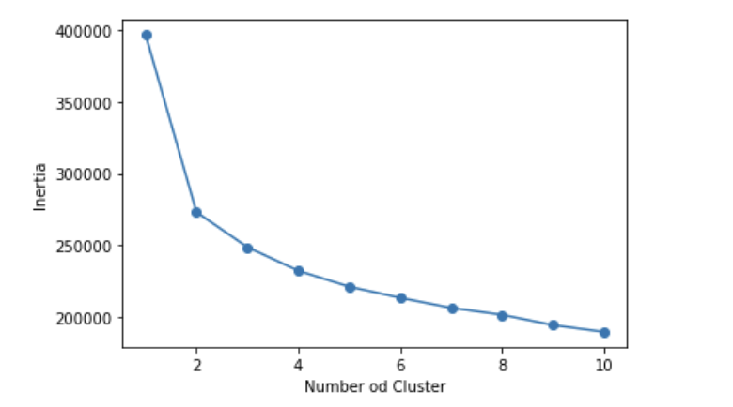
k-means clustering

Slide 16
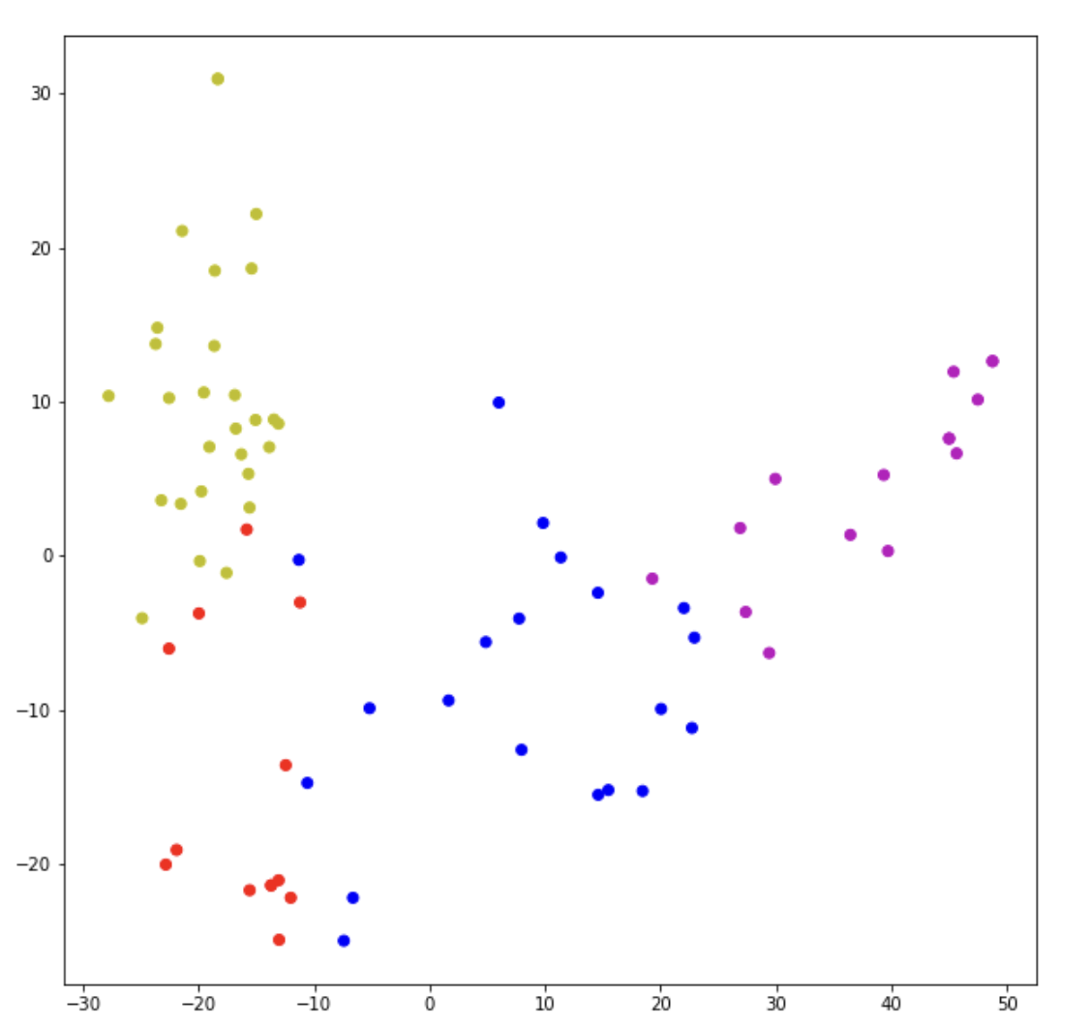
k-means clustering
Reflects the strength of relationship between two data

Slide 17
NMF
PCA
LDA
Livvic
Count Vectorizer and TF-IDF Vectorizer.
Count Vectorizer and TF-IDF Vectorizer.
Count Vectorizer and TF-IDF Vectorizer.
Corex
Count Vectorizer and TF-IDF Vectorizer.

Slide 18
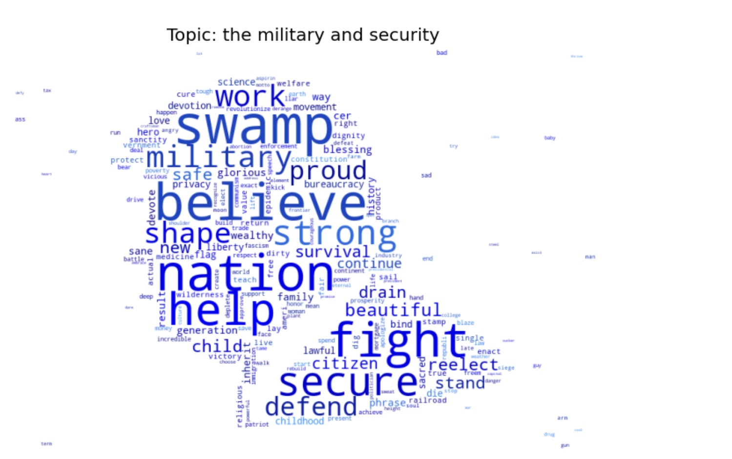

Slide 20
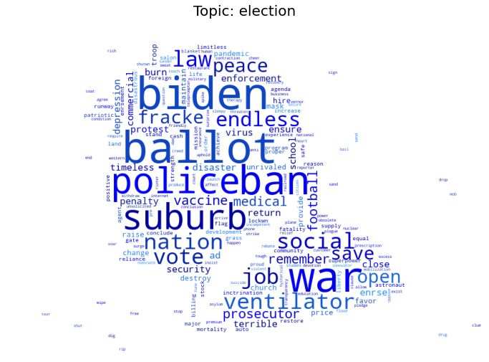

Slide 21
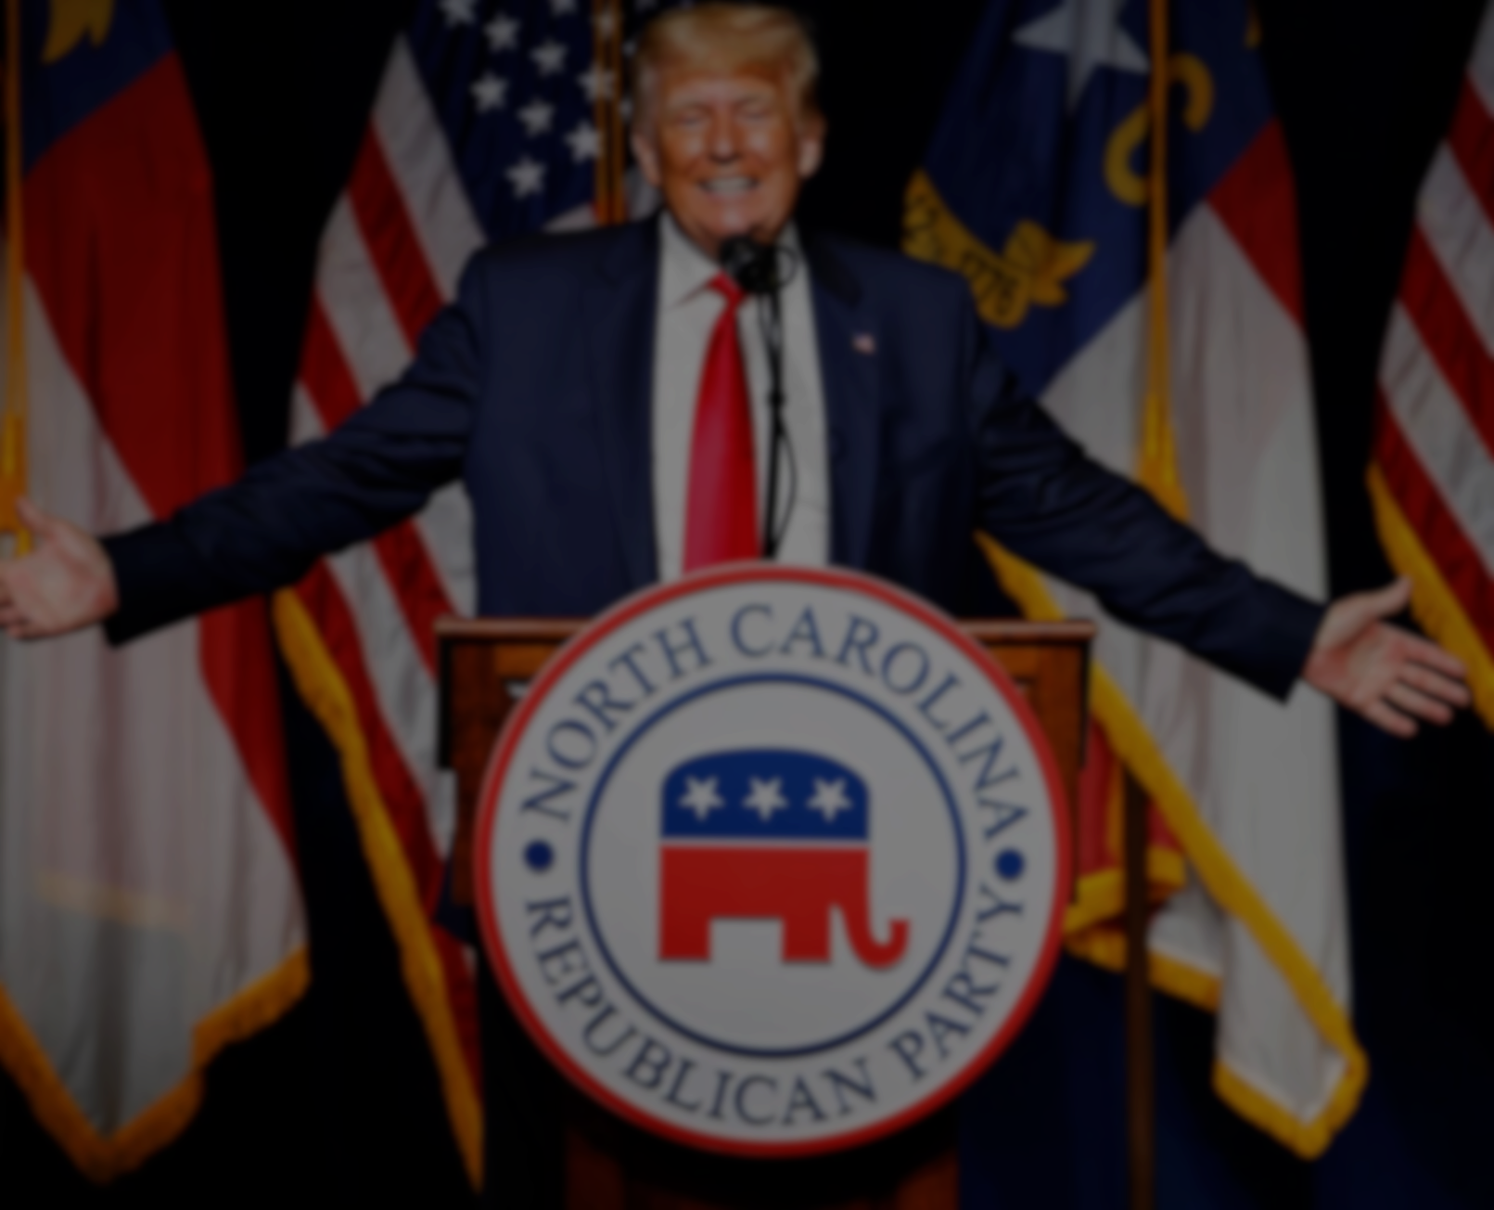
Thanks.

